Slide 1
Understanding InBody Parameter Calculations and Interpretation

Slide 2
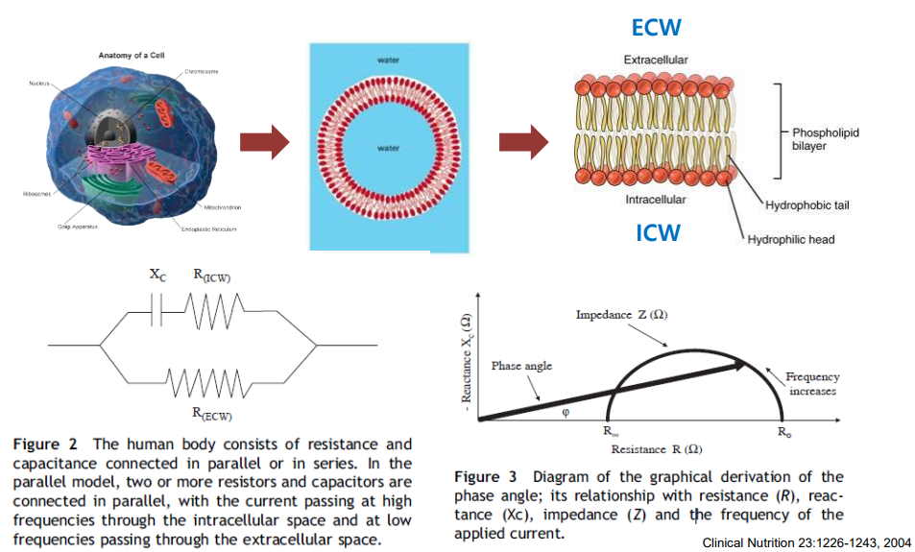
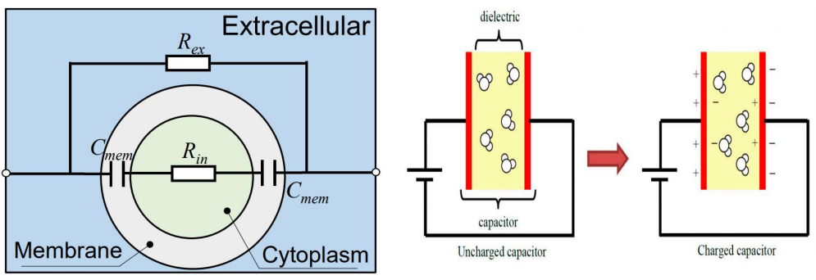
02
Application of InBody Parameters – Phase angle
4
Severity Check
In the human body, the cell membrane consists of two layers of lipoproteins. Inside, there's a lipid layer, while the outer layers on both sides are composed of water-friendly protein layers, serving as a scaffold. Xc represents the resistance component generated in the scaffold-like cell membrane, and PhA is proportional to Xc. PhA is correlated with cell/cellular membrane health.
Clinical Nutrition 2004;23:1226-1243

Slide 3
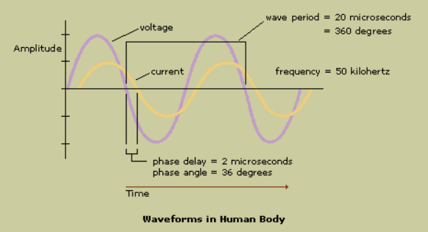
02
Application of BWA in Dialysis Patients
4
Severity Check
Using the BIA method, sending alternating current through the human body yields impedance (Z) values, which can be distinguished into resistance (R) and reactance (Xc). Since PhA represents the relative Xc value to R, PhA increases as Xc increases, and PhA decreases proportionally as Xc decreases.
Clinical Nutrition 2004;23:1226-1243

Slide 4
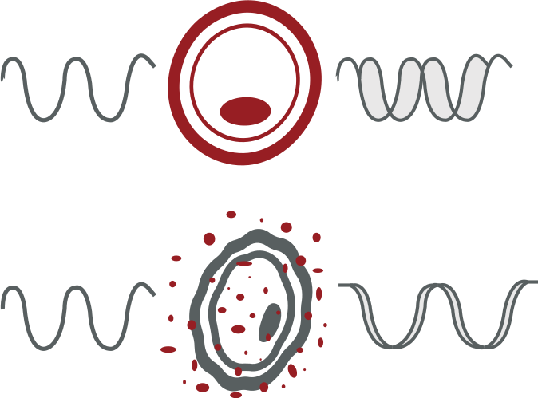
02
Application of BWA in Dialysis Patients
4
Severity Check
Phase angle represents structural integrity and physiological functionality of the cells Used for nutritional assessment.
Healthy Cell
Damaged Cell
Membrane
U max
I max
50KHz
50KHz
Phase Angle
Intact cells with high membrane integrity
Damaged cell or low cell density
High Phase Angle
Low Phase Angle
Improvements in cell membrane and functionality → Phase angle increase
Deterioration cellular integrity and selective permeability → Phase angle decrease

Slide 5
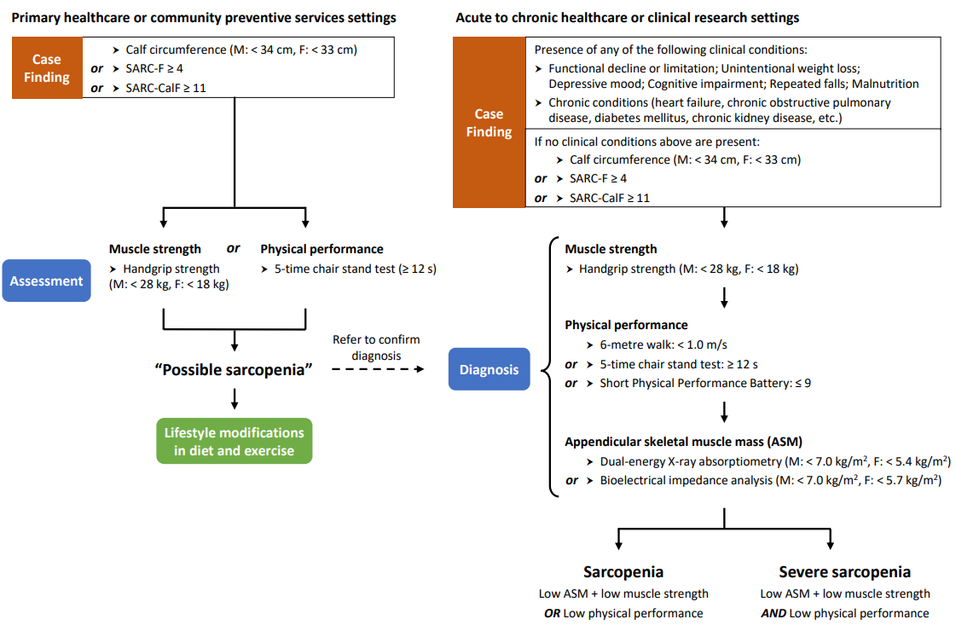

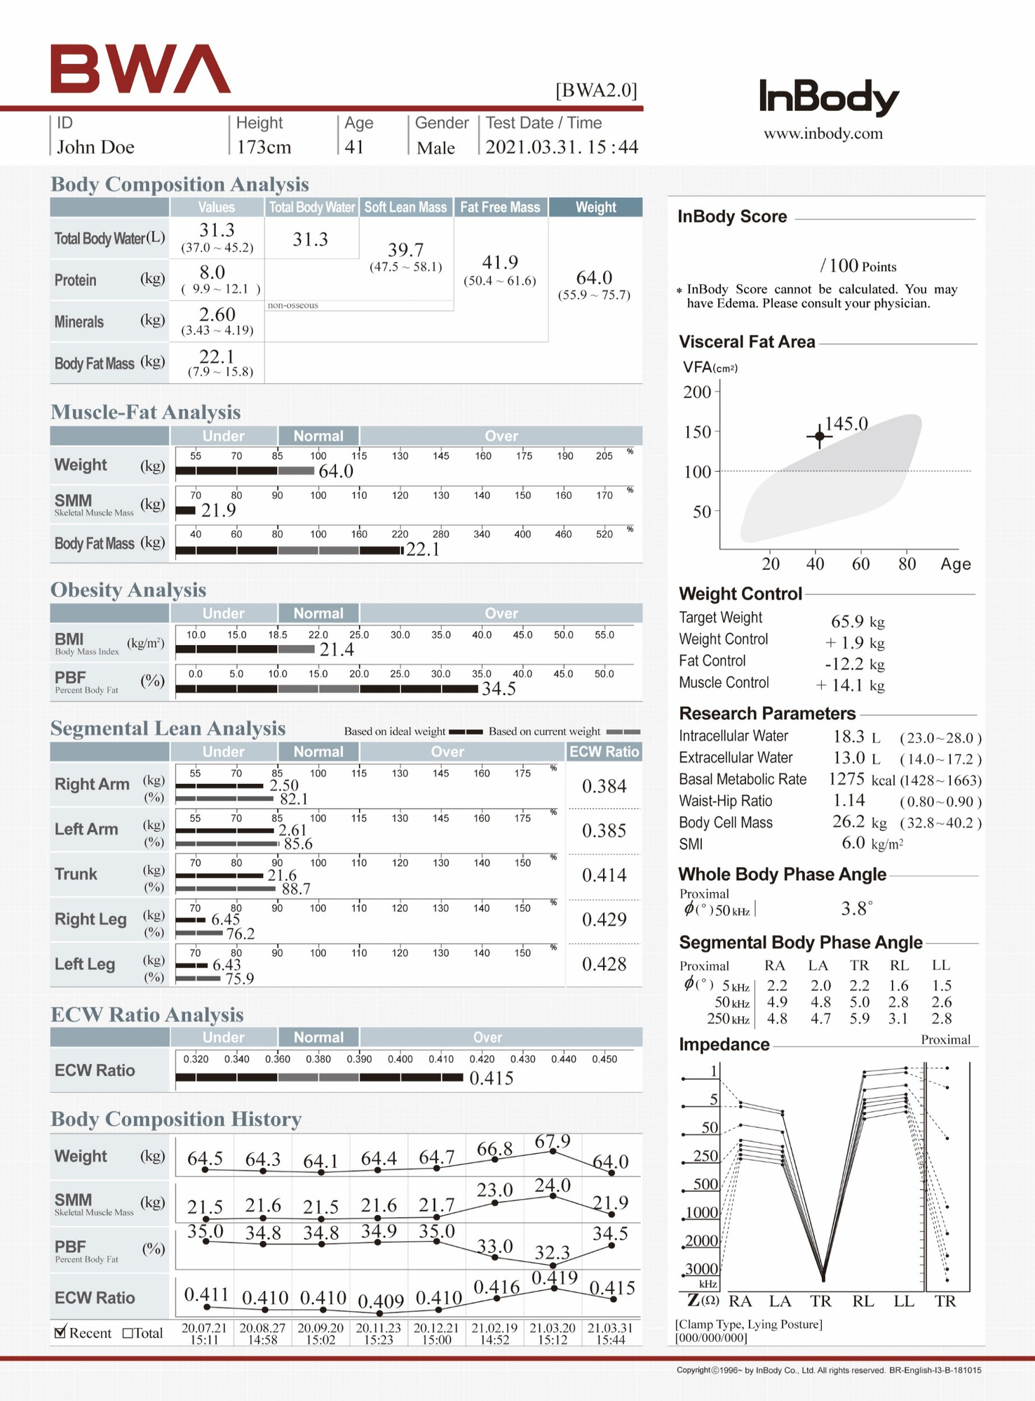

02
Application of InBody parameters - SMI
SMI
Skeletal Muscle Mass Index (SMI)
Age 41, 173cm, 64kg
Limb SMM ÷ height squared
(2.50 + 2.61 + 6.45 + 6.43) ÷ 2.99 = 6.01
Fig 1. AWGS 2019 algorithm for sarcopenia. F, female; M, male. (Chen et al., 2020)
‹#›/34

Slide 6
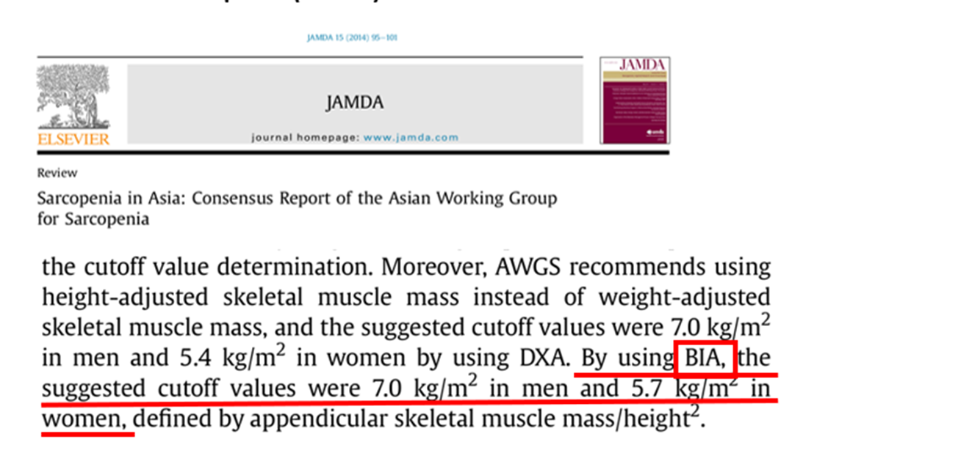
Skeletal Muscle Index

Slide 7
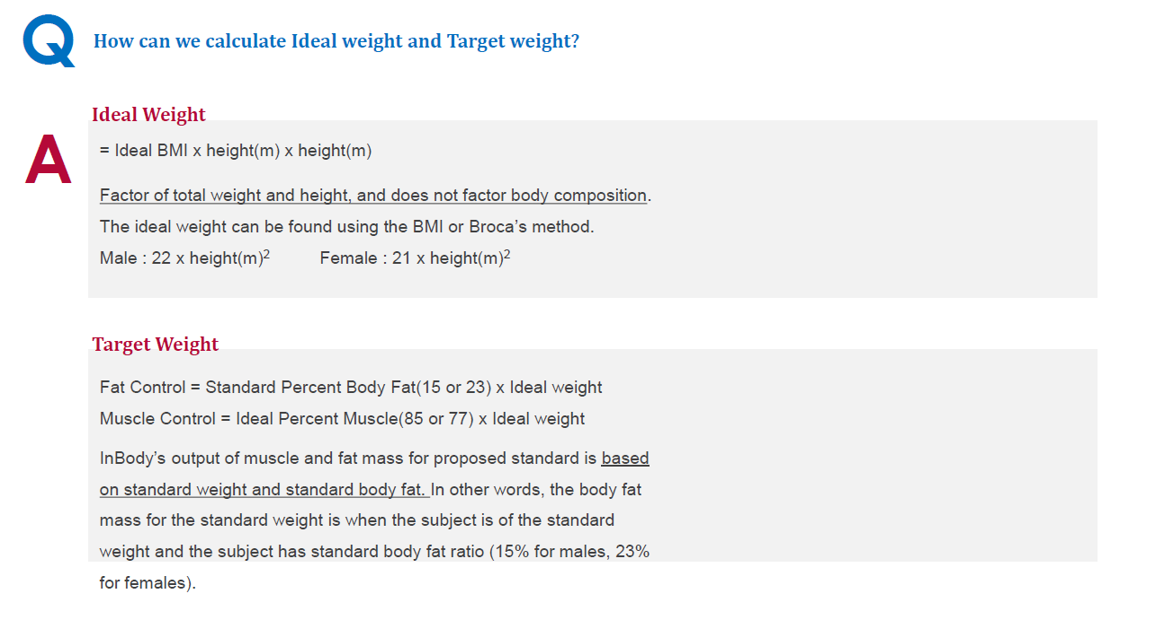
Target Weight

Slide 8
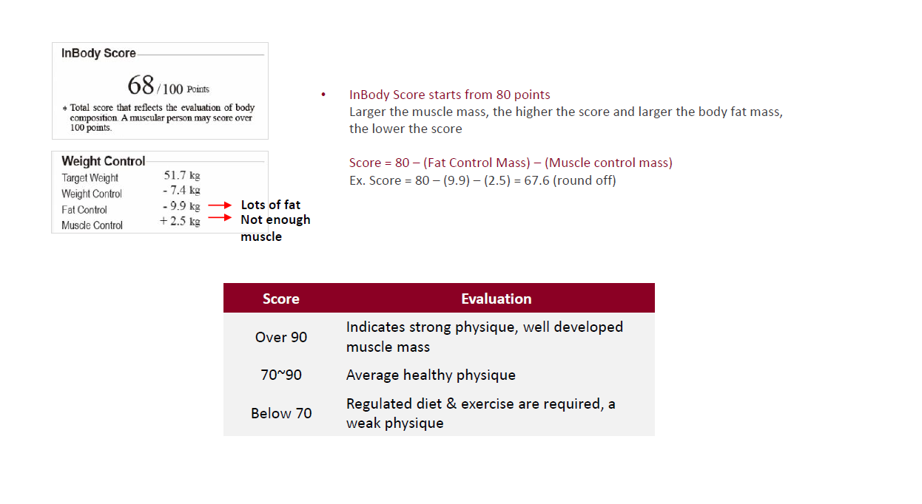

Slide 9
Obesity Degree
Obesity Degree is an index that indicates the level of obesity by comparing the standard weight and the current weight, without taking body composition into account.
Formula: (Current body weight) / (Standard weight)*Standard weight : Male: 22 * (height)² (m²)Female: 21 * (height)² (m²)
Evaluation:
below 90% : Underweight
90-110% : normal
above 110% : Overweight
above 120% : Obese

Slide 10
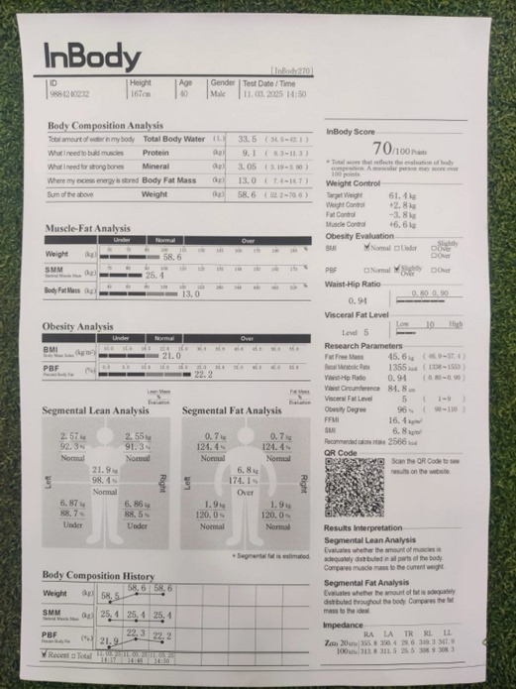
Case 1-
the case:
Standard weight: 22 * 1.67 * 1.67 = 61.3558 kg
Current weight: 58.6 kg
Obesity degree : 58.6 / 61.3558 = 0.95508 = 96% (round up)

